Slide 1
Advanced Manufacturing Workflows for Tokamak Internal Components Commonwealth Fusion Systems CRADA
ORNL
Andrzej Nycz
Yukinori Yamamoto
Luke Meyer
Bill Carter
Chris Masuo
CFS
Brandon Sorbom
Cody Dennett
Shiyun Ruan
Jeremy Hollman
Deepthi Tammana
Moses Bloom

Slide 2
Intro Video

Slide 3
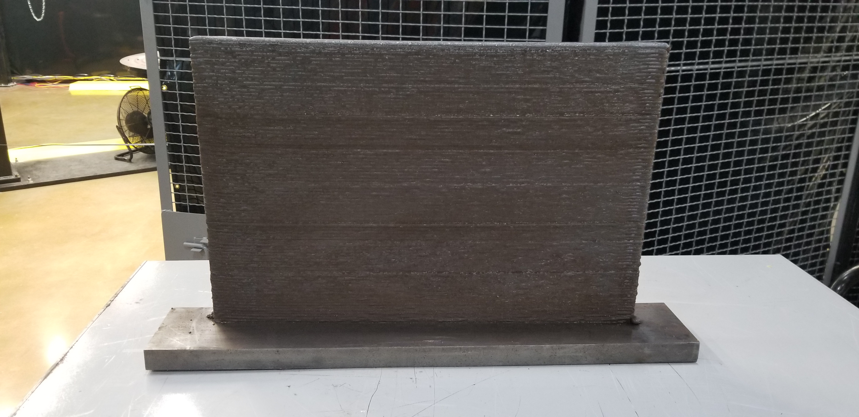
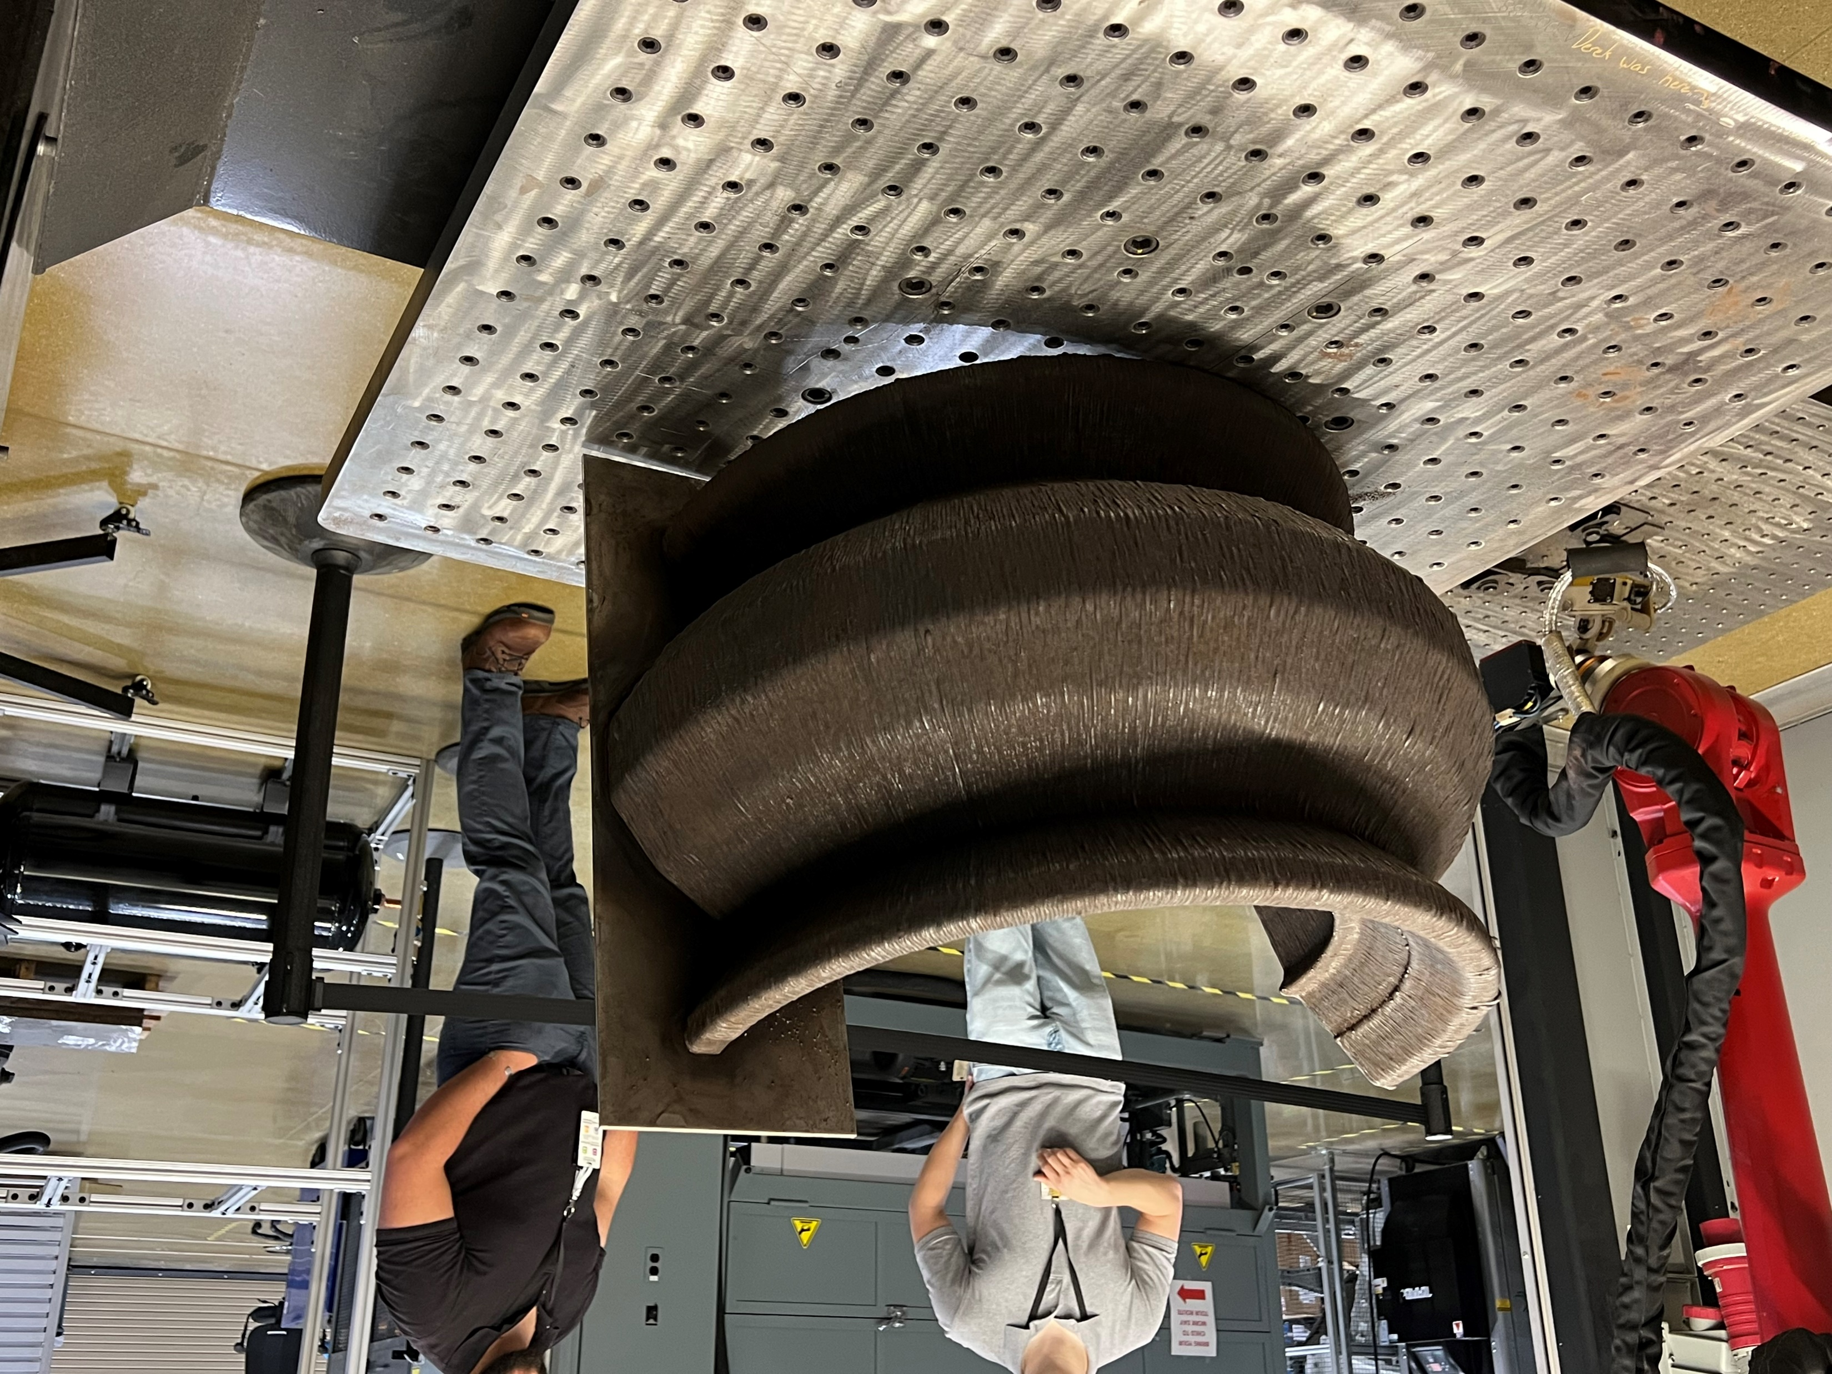
Advanced Manufacturing Workflows for Tokamak Internal Components
Objective: create and demonstrate workflow to build a component of the ARC vacuum vessel
Approach
identify a group of suitable materials
Select a component
Create a testing workflow
Demonstrate
Down

Slide 4
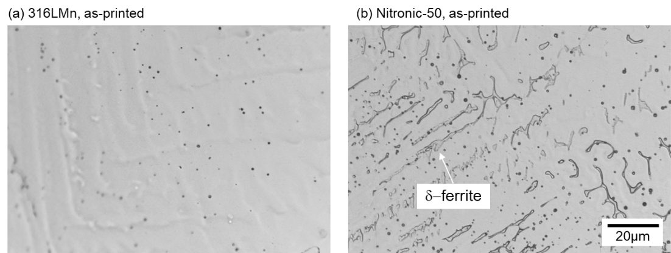
Materials: 316LMn Nitronic 50
Properties:
As printed,
Heat treated
Microstructure, Yield strength, Ultimate Tensile strength, Elongation, Reduction of Area, Charpy toughness, fracture toughness, microstructure

Slide 5
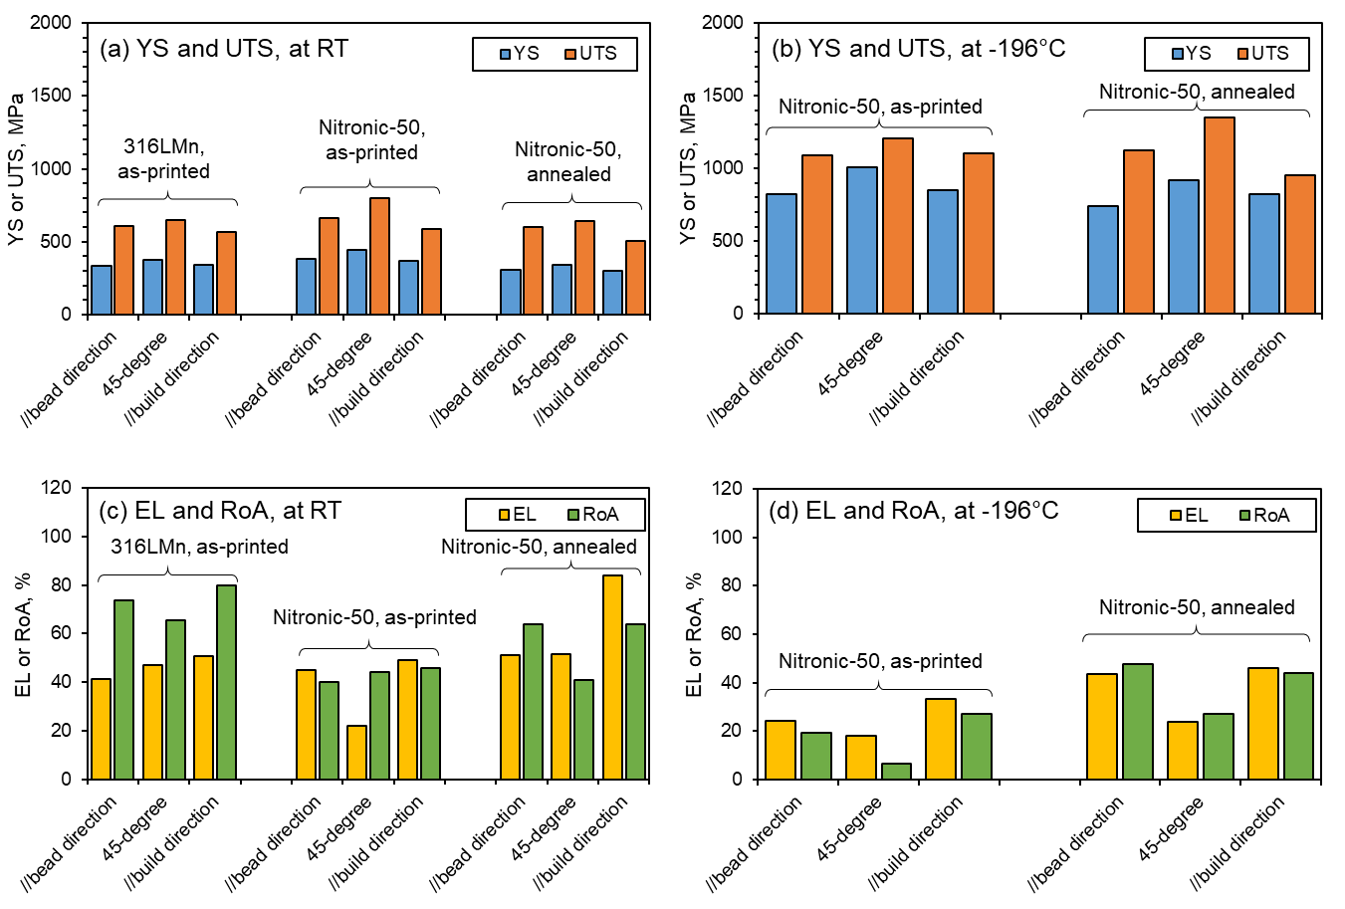
Materials: 316LMn Nitronic 50
No major anisotropy in tensile strength
45deg highest YS
No major effect on tensile strength from annealing
YS, UTS lower than wrought, EL higher

Slide 6
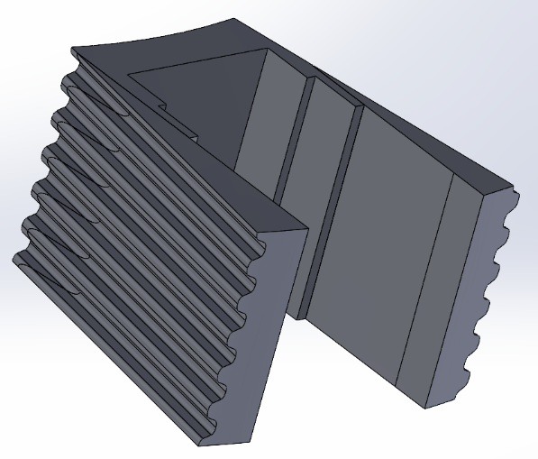
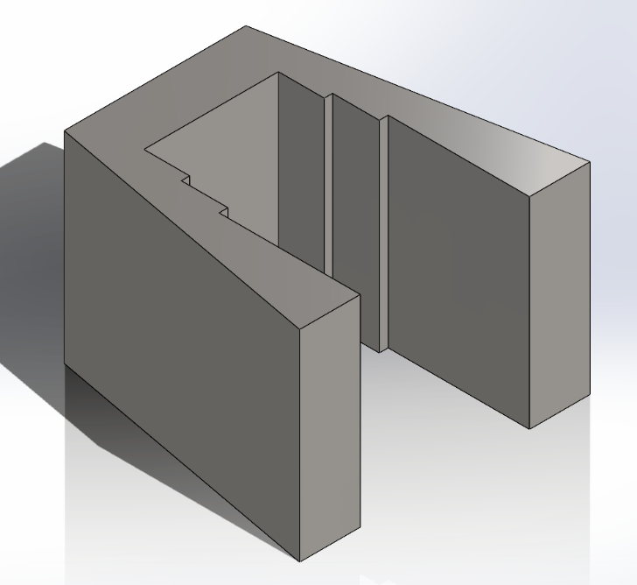
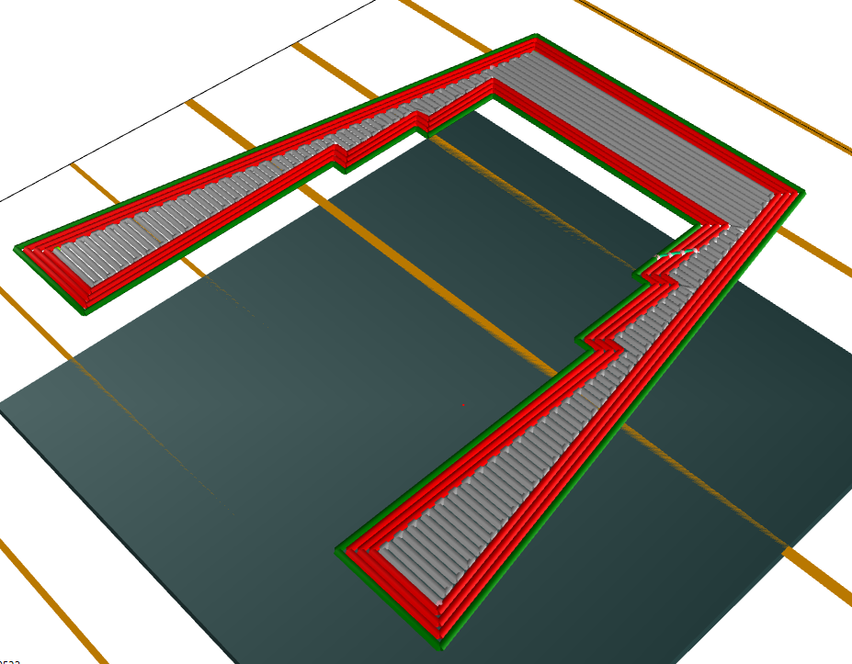
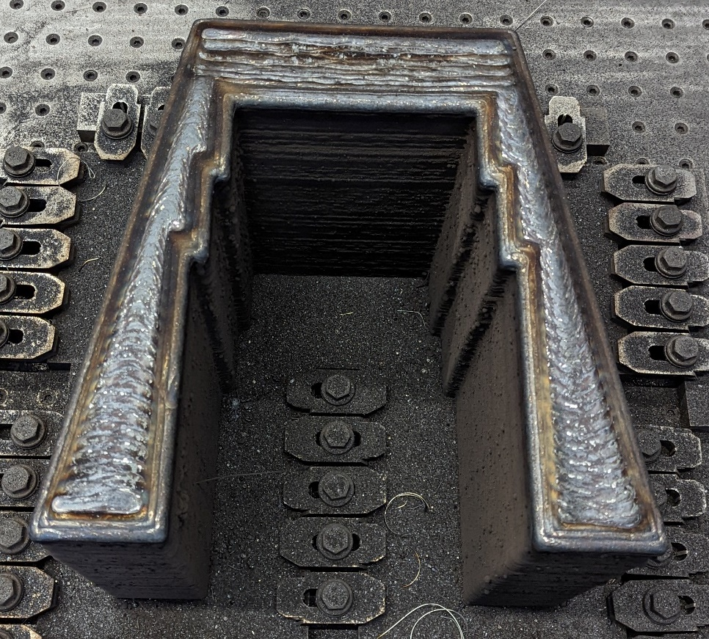
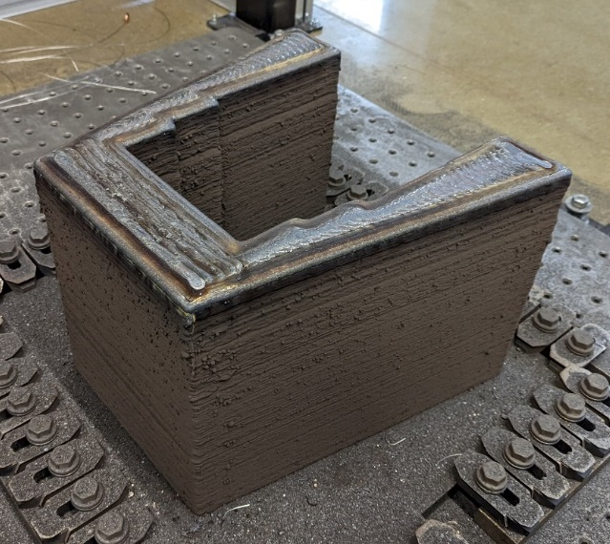
First test part
Tokamak support leg test
Minimizing material waste
Workflow: defeature, toolpath, test print, final print
11.5” H, 17” L, 17” W. ~400lb
Model of the Support leg. Original part- left, defeatured model - right.
Print direction
Toolpath visualization
Manufactured near net shape support leg.

Slide 7
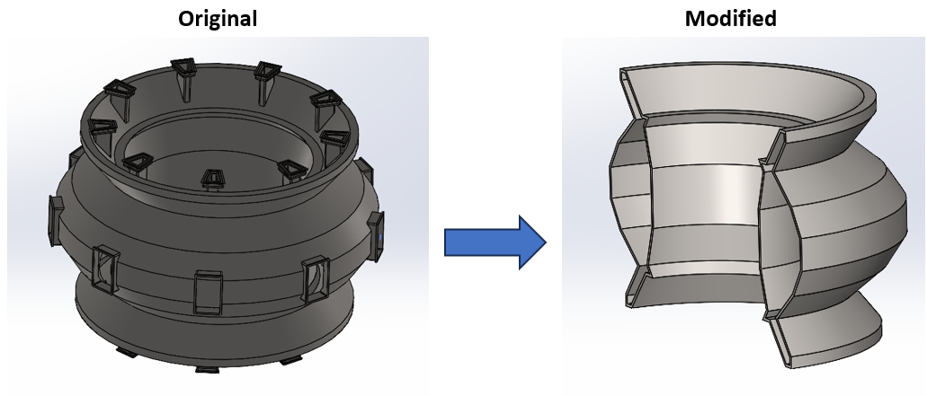
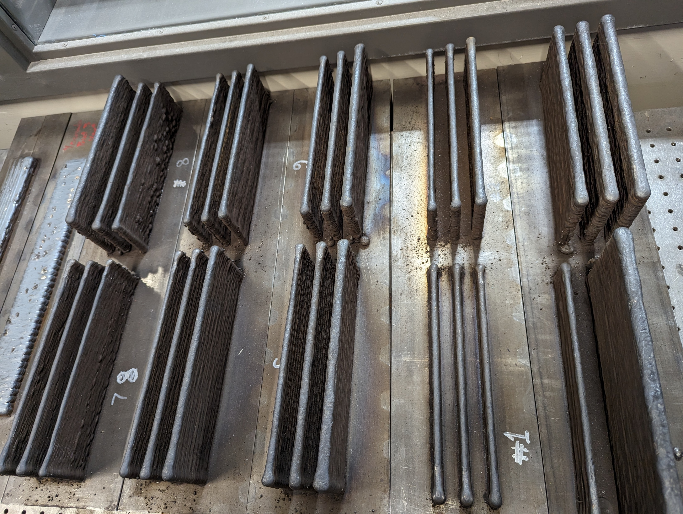
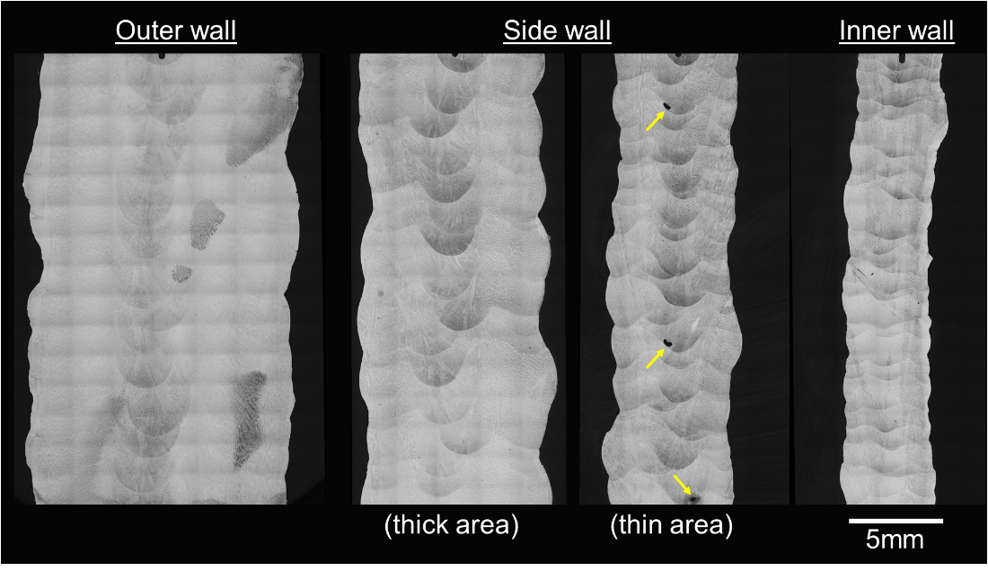
Process development and controls
Nonstandard print direction
New process development
New process controls
Mechanical properties
Print direction
Figure 14. Average layer height as a function of wire feed and print head speed

Slide 8
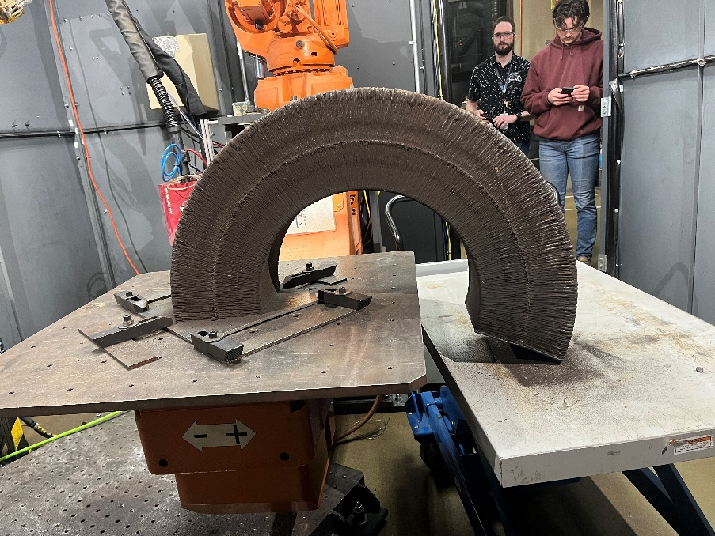
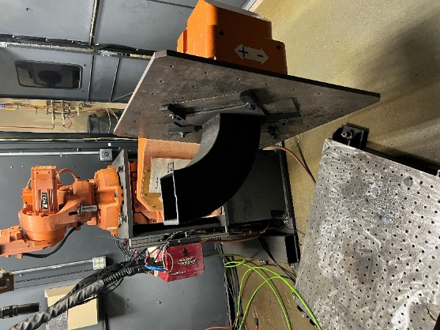
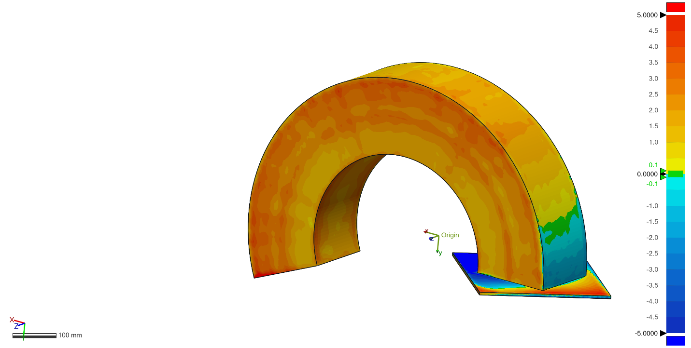
Concept test
Simplified geometry test
All previous concepts in action
3D Scan
Scan vs CAD 1.06mm – typical deviation
Test part during the print (left) and the finished part (right).
Scanned toroidal test component. Color representing deviation from the model.

Slide 9
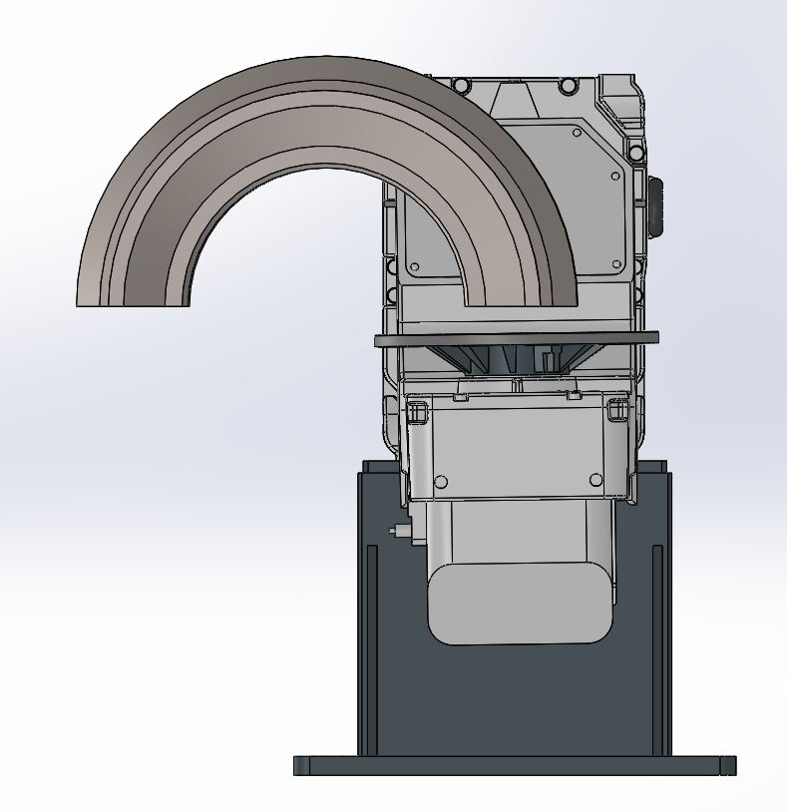
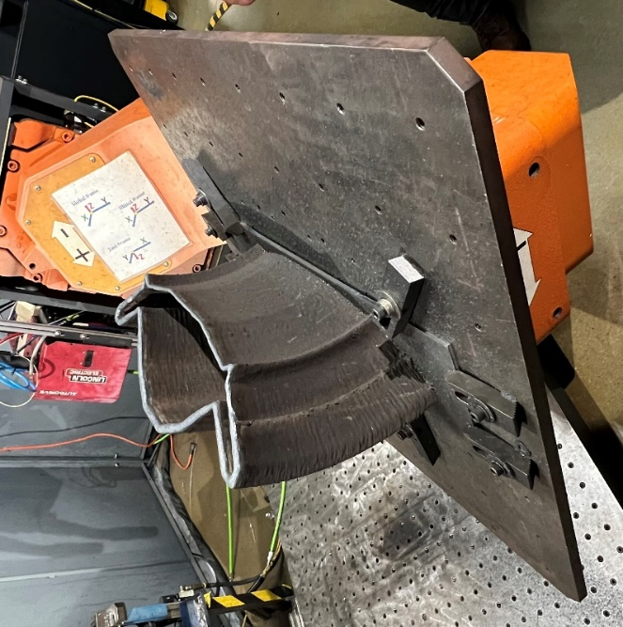
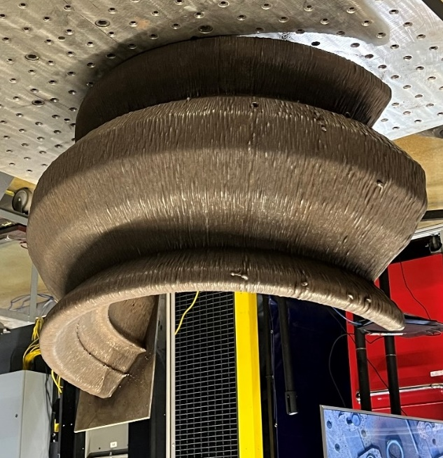
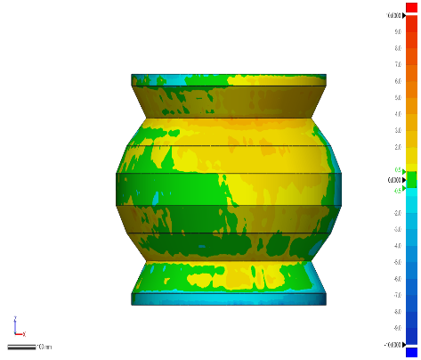
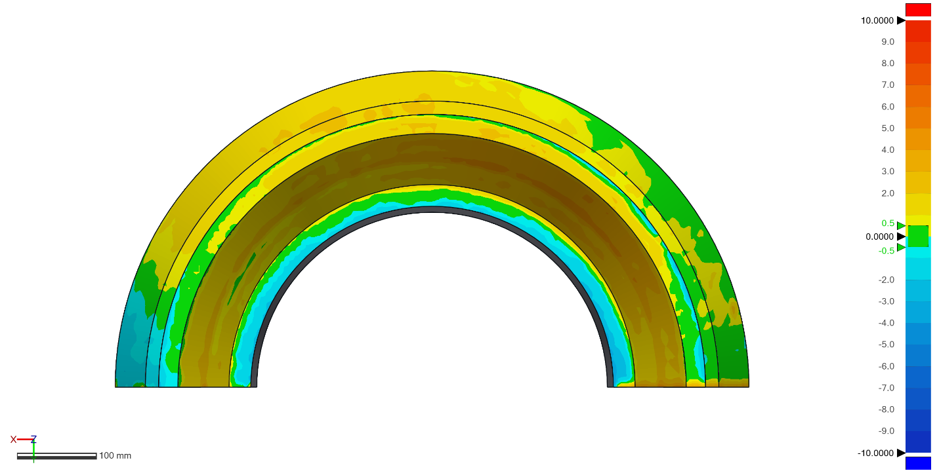
Toroidal part production
316LMn – feedstock
Full workflow
3D scan
0.85 mm deviation
Model of the shield (left), defeatured part (middle), modeled part on the positioner.
ORNL slicer Toolpath (left) and part cross section bead model (right).
Final part during manufacturing (left) and finished part (right).
Heatmap comparison of the printed part and the model (not to scale).

Slide 10
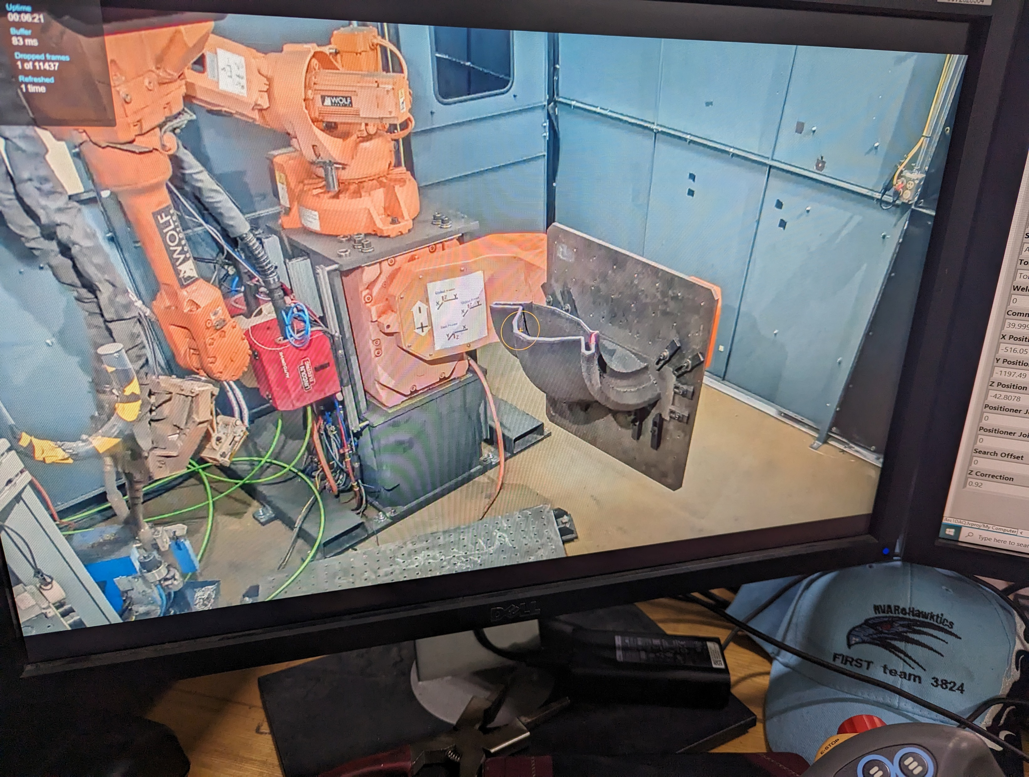
Conclusions
Evaluated mechanical properties and selected materials: Nitronic 50, 316LMn
Workflow created
Process development
Demonstration of future manufacturing

