Slide 1
Overview of Fusion Safety Program Capabilities at the Idaho National Laboratory
Brad J. Merrill, Masashi Shimada, Paul W. Humrickhouse, Chase N. Taylor, Thomas F. Fuerst and Robert J. Pawelko
INL Fusion Safety Program
Knoxville 2019 INFUSE Meeting
November 23rd , 2019

Slide 2
Overview
The Idaho National Laboratory (INL) Fusion Safety Program (FSP) is the Office of Fusion Energy Sciences’ (FES) lead laboratory for Magnetic Fusion Energy (MFE) Safety.
To achieve our mission, the FSP maintains core competencies in several areas, two of which are: tritium retention and permeation in fusion plasma facing component (PFC) and blanket materials and fusion safety code development
Recent advances and future plans in the following areas:
  Upgrades at the Safety and Tritium Applied Research (STAR) facility to develop two new tritium research experimental capabilities
  Development of the MELCOR-TMAP computer safety code

Slide 3
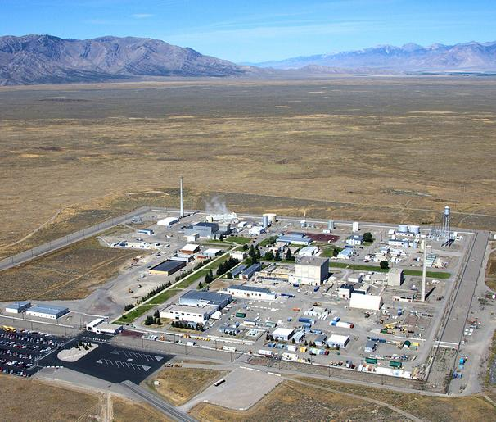
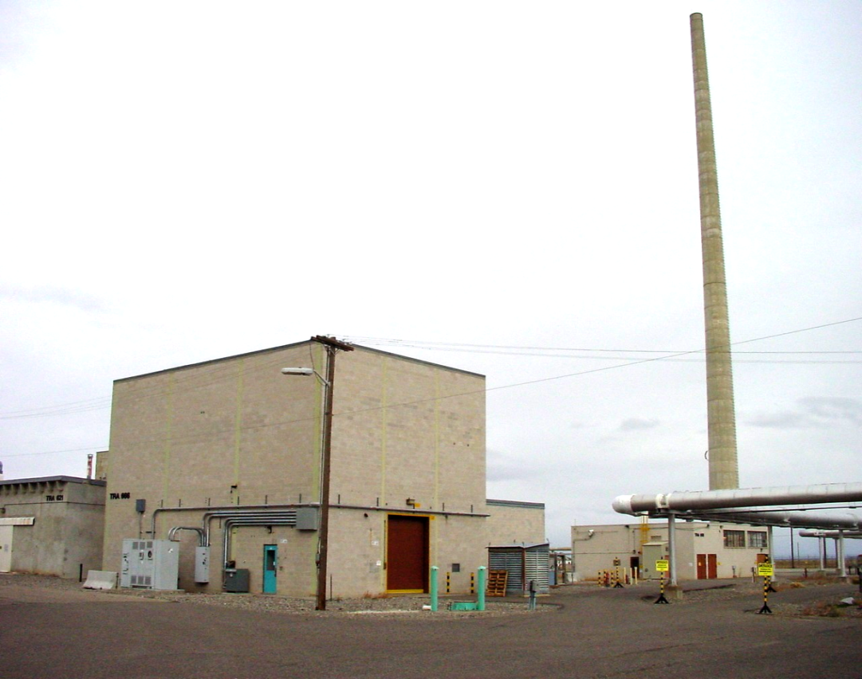
Safety and Tritium Applied Research (STAR) Lab Located at the INL Site…
STAR is FES’s tritium and materials safety data experimental research facility at INL
It’s a DOE less-than Hazard Category 3 Nuclear Facility capable of handling low radiation levels (e.g., W, Ni, Mo, T₂) : contact dose < 1.5 mSv/h, annual dose < 7 mSv/y, T₂ inventory <1.6 g
STAR’s research priorities continue to be:
In-vessel tritium source determination:
  Tritium retention in plasma facing components (PFCs)
Blanket & Ex-vessel tritium permeation testing:
  Tritium permeation through PFCs and blanket/structural components
In-vessel dust source term evaluation:
  Dust characterization and explosive potential
STAR

Slide 4
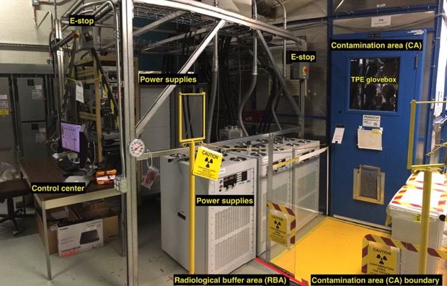
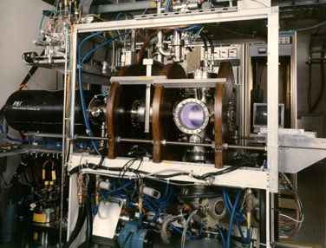
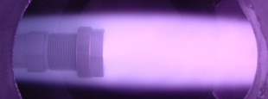
TPE - Tritium Plasma Experiment
TPE is a unique linear plasma device in four elements:
  Tritium plasma (< 500 Ci per discharge),
  Divertor-relevant high-flux plasma (>10²² m⁻²s⁻¹) ,
  Moderately radioactive (< 1 mSr/hr @ 30 cm) materials handling
  Beryllium handling
Utilizes two containments other than its SS vacuum vessel
  Ventilated enclosure (as a high contamination area/HCA boundary)
  Ventilated PermaCon room (as a contamination area/CA boundary for T)
Plasmas modifies PFC surfaces and implanted hydrogen isotopes drives large permeation fluxes and inventories compared to gas pressure driven permeation

Slide 5
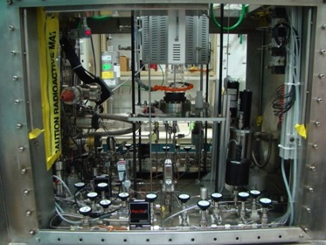
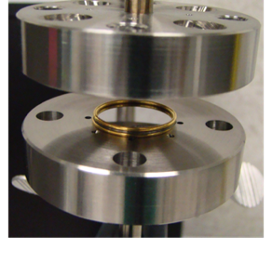
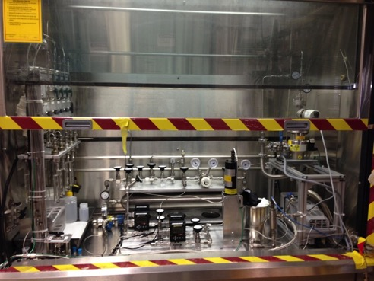
  TGAP - Tritium gas absorption and permeation
TGAP is a unique tritium permeation experiment in five elements:
  Tritium (T₂) gas (< 25 Ci per campaign)
  Independent control of H₂ and T₂ partial pressures
  Low tritium partial pressure (10⁻¹² < p_{T2} [Pa] < 10⁰ )
  Moderately radioactive (< 1 mSr/hr @ 30 cm) materials handling
  Liquid (e.g., PbLi, FLiBe) and disc shaped metal specimens
Utilizes a Ventilated Enclosure for tritium confinement

Slide 6
TGAP Tritium D/T Permeability Studies in Fusion Material
Research Activity
Expanding tritium data in mass transport database
Limited data exists for tritium mass transport properties in fusion materials in general, and there is a research need to measure isotope effects in these materials.
Research Impact
In polycrystalline tungsten, anticipated isotope effects were not clearly observed, and higher than expected T permeability at low temperature (< 973 K) might be associated with grain-boundary effects.
In RAFM steel, higher isotope effects were observed higher than expected mass ratio [D vs T (1.22~sqrt(3/2)]. Permeation for both isotopes was demonstrated to follow a square root dependence on Q₂ partial pressure (diffusion limited for both Q=D or T) in the range from 10⁻¹² to 10⁵ Pa.
D and T permeability in polycrystalline W
D and T permeability in RAFM steel
STAR Publications
M. Shimada, R.J. Pawelko, Fusion Engineering and Design 129 (2018) 134
M. Shimada, R.J. Pawelko, accepted for publication in Fusion Engineering and Design.

Slide 7
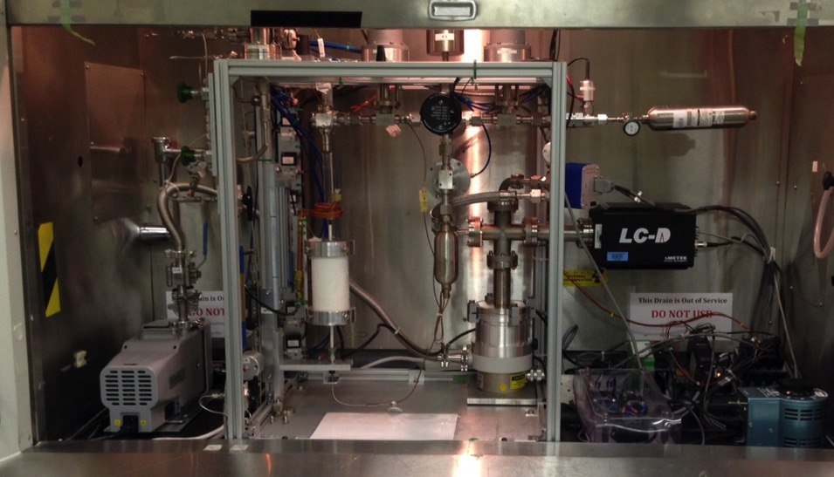
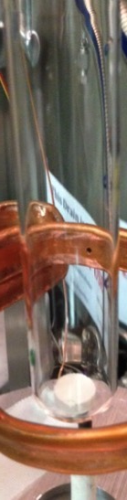
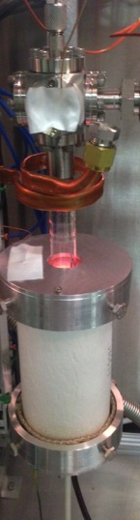
SGAS - Static Gas Absorption System
SGAS is a unique hydrogen/deuterium experiment in four elements:
  Deuterium gas pressure (10³< p_{D2}[Pa] < 10⁵ )
  High temperature (up to 950 °C)
  Liquid or ceramic breeder materials (PbLi, FLiBe, Li₂ZrO₃, etc.) and PFC/structural material (W, RAFM steels, etc.)
  Moderately radioactive (< 1 mSr/hr @ 30 cm) materials handling

Slide 8
STAR Material’s Diagnostic Capabilities
In-house capabilities needed to characterize tritium contaminated samples
Tritiated samples are difficult to ship
Even more difficult for collaborators to receive
Analysis capabilities
  Composition/chemistry
    Surface
    Bulk
  Morphology
  Defect structure
GD-OES
XPS
SAM (AES)
SAM (SEM)
CLSM
PAS
 |  |  | 1 nm | 10 nm | 100 nm | 1 µm | 10 µm | 100 µm | 1 mm
 |  | Interrogation depth/scale
Composition
Morphology
Defects

Slide 9
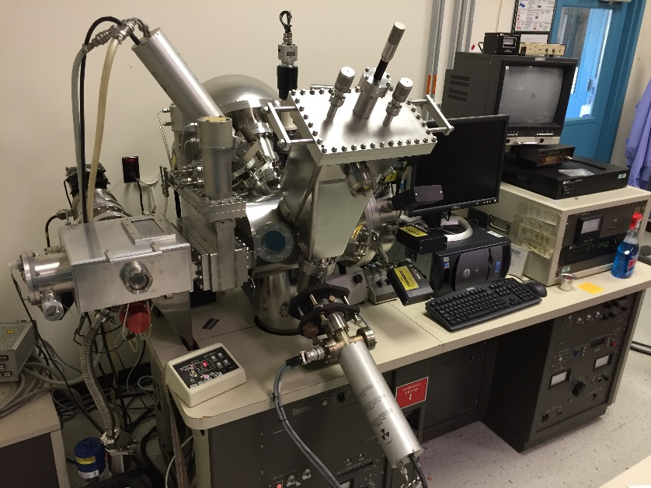
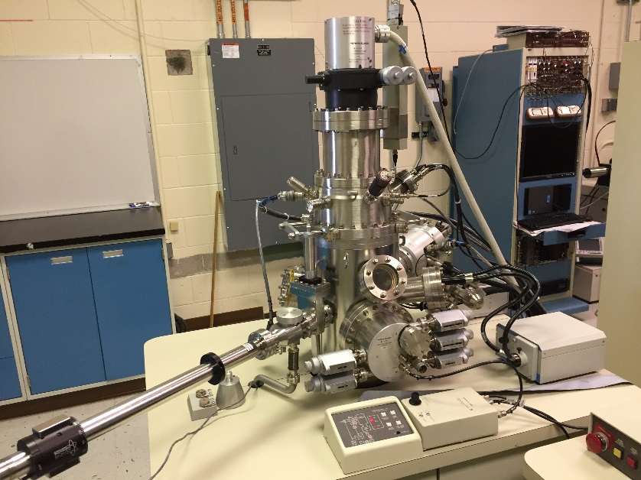
Analyzing Material Surface Composition
Surface chemistry dictates permeation and plasma-surface interactions.
X-ray photoelectron spectroscopy (XPS)
  Quantify surface chemistry.
  Sensitive to top 1-10 nm.
  High resolution X-ray monochromator.
Scanning Auger microprobe (SAM)
  Elemental composition of materials.
  2D surface elemental mapping.
XPS
SAM
Notes:
“surface” as opposed to EDS, which is from the bulk.

Slide 10
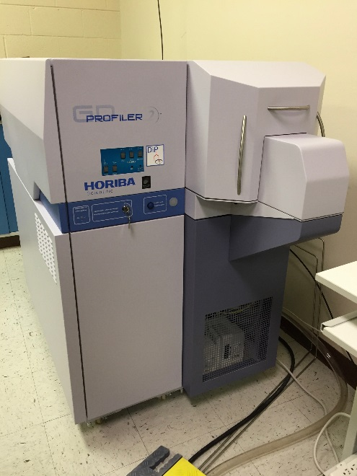
Analyzing material composition - Bulk
Technique
  Elemental characterization with depth profiling.
  Analyzed 10s of elements simultaneously.
  Nanometer depth resolution.
  Sputtering rates of µm/min.
Specifications
  Capable of differentiating H and D.
  Real time depth measurements.
  Monochromator can be used to look at unknown element.
GD-OES is capable of measuring the D depth profiling from bulk (>> 10μm) neutron-irradiated tungsten exposed to plasma.
Plotting the smoothed data (50 point averaging) semi-log scale in (b) indicates that smaller quantities of deuterium are found up to >20 μm in the sample.
C.N. Taylor and M. Shimada, AIP Advances. 2017 (5) 055305.

Slide 11
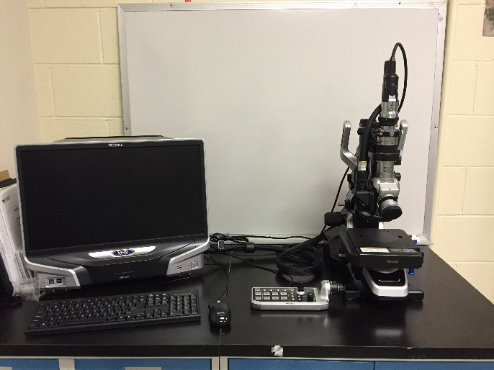
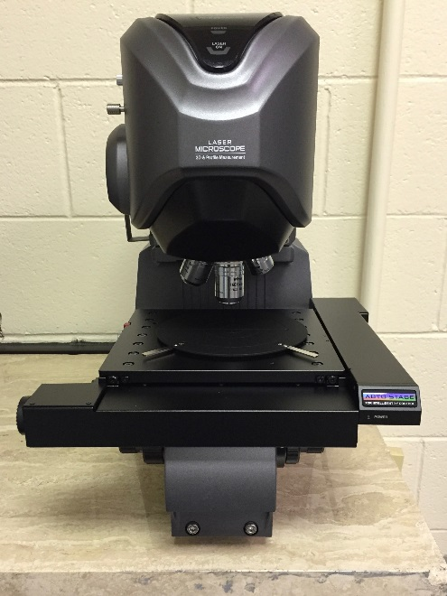

Measuring Morphology
Three instruments for characterizing microstructure
  General purpose microscope
  Confocal laser scanning microscope (CLSM).
  Scanning Auger/electron microscope
Goal: correlate radiation damage (morphology) to retention/permeation.
Microscope
10µm
SAM
CLSM
C.N. Taylor et al., Deuterium retention and blistering in tungsten foils, Nucl. Mater. Energy (2017)

Slide 12
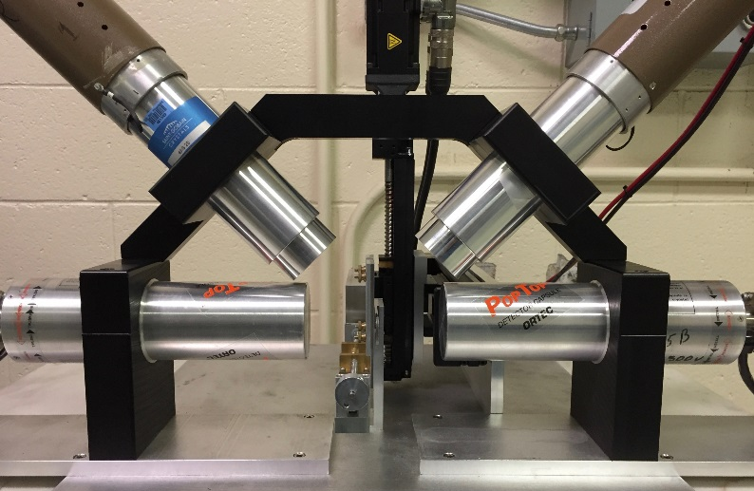
Interrogating Defects
Voids and vacancies increase tritium retention in materials.
Correlate neutron damage to retention.
Positron annihilation spectroscopy (PAS)
  Positron annihilation lifetime spectroscopy
    Provides the defect size
  Coincidence Doppler broadening (CDB) PAS
    Provides the relative defect concentration.
511 keV
β⁺
Defect rich samples have a sharper 511 keV peak, larger S-parameter.
511 keV
Taylor CN, et al., Physica Scripta. 2014, T159:014055.
Taylor CN, et al., J. Nucl. Mater. 2015, 463:1009–12.

Slide 13
New STAR Facility Experimental Capabilities
Two New Tritium Science Experiments under development at STAR
  Upgrades
    Super-permeable membrane testing experiment
    Breeding blanket coolant tritium extraction loops
  Safety Background
    Tritium recovery from tokamak plasma exhaust stream directly recycling it to the fueling system can significantly reduce inventory in reactor tritium processing plant
    Efficient extraction of tritium from reactor blanket coolant streams is required to control permeation releases into reactor building

Slide 14
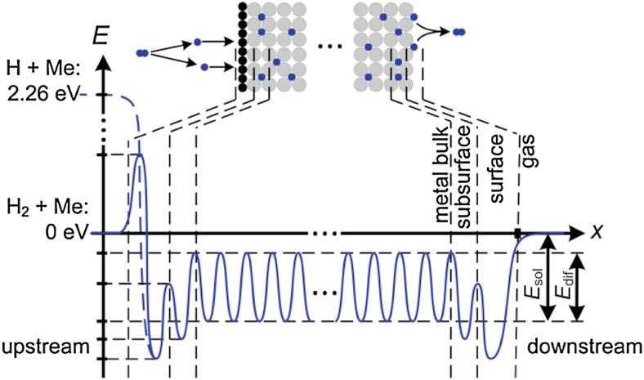
Development of a super-permeable metal pump testing facility
What are super-permeable metal foil pumps?
  A pumping technology utilizing “super-permeation” in metals (e.g. V, Ta, Nb, ⍺-Fe, Pd etc.) to pump only hydrogen isotopes quickly through the metal foil membrane [1-5]
Potential benefit of these pumps?
  Steady state passive vacuum pump (no moving parts)
  Reduce the size of tritium plant by ~75% by direct recycle
How does super-permeation work?
  Utilizes surface barriers (e.g. monolayers of oxide to create asymmetric permeation of hydrogen isotopes (H,D,T)
  Requires super-thermal hydrogen atoms (kinetic energy > 1 eV) implanted past a non-metal surface barrier that reduces back diffusion and allows for rapid permeation through the metal foil to opposite metallic (or metallic film) surface
  Impermeable to plasma exhaust impurities (helium)
Figure from Ref. [3]
References:
[1] A.I. Livshits et al, Appl. Phys. A. 80 (2005) 1661
[2] Ch. Day and T. Giegerich, Fus. Eng. Des. 88 (2013) 616,
[3] B.J. Peters and Ch. Day, , Fus. Eng. Des. 124 (2017) 696
[4] B.J. Peters S. Henke and Ch. Day, , Fus. Eng. Des. 136 (2018) 1467
[5] F. Waelbroeck, et al., KFA Report No. Jul-1966, (1984)

Slide 15
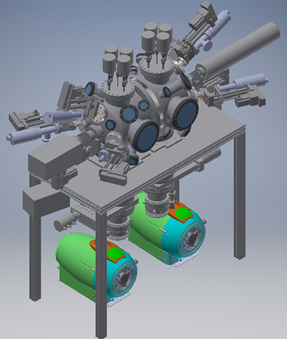
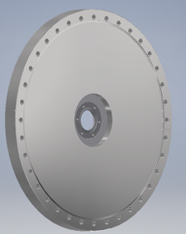
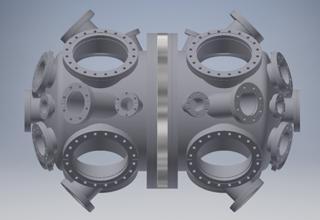
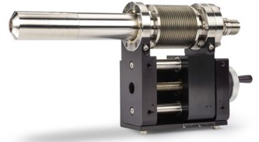
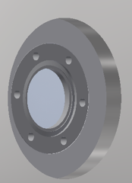
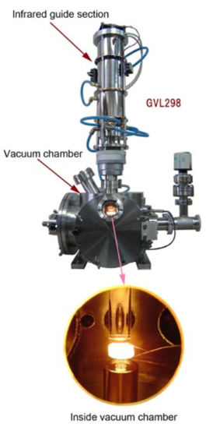
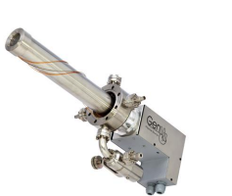
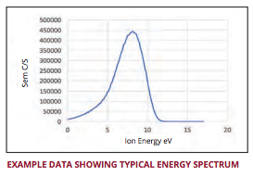
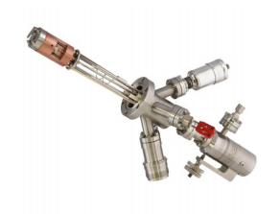
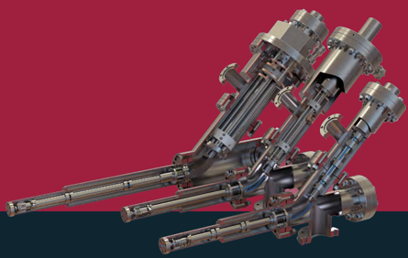
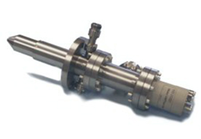
Permeation Experiment for Asymmetric Surfaces (PEAS) Under Development
Combined source capabilities with
  Gas-driven H₂/D₂ permeation
  Low-flux ECR plasma
  Low-flux ion beam (e.g. Ar, O, N)
  Atomic H/D source
  Filaments (e.g. W, Ta, Nb)
Symmetrical vacuum chamber
sample flange
Compact Auger analyzer
Middle flange
with multiple view ports for diagnostics
ECR plasma source
Use of advanced heating technology
  Heating capabilities to 1000°C with infrared beam
  Heats 1.5 inch (38 mm) OD disc uniformly across membrane
In-situ or in-vacuo surface characterization on both side
  Total 14 view ports (1x 0 ͦ , 8x 30 ͦ , 4x 45 ͦ ports, 2x 60 ͦ ports) each half
  Vacuum vessel allows for wide solid angle for surface characterization
  Various surface and ion and neutral energy analyzer are under consideration
Atomic H source
Ar ion sputter gun
Ion/neutral energy analyzer
IR beam heating system

Slide 16
Planned Super-permeable Membrane Research
Explore candidate materials:
  Group V metals (V, Nb, Ta)
  ⍺-Fe, Ni, RAFM
  Pd (or Ni) coated membranes
  Multi-layered materials (e.g. V/porous-Al₂O₃/Pd)
Key issues to resolve:
  Physics of potential surface barriers
  Producing and controlling asymmetrical barriers
  Effects of impurities
    in gas exhaust (e.g. He, H₂O, Ne, etc.)
    in metal (e.g. N, O, C)
Research needs:
  In-situ or in-vacuo surface characterization before/after H/D permeation test
  Combined gas- and plasma-driven permeation system that can produce hyper-thermal H atoms (>1 eV). Measurement of ion/neutral energy distribution in system
Technology needs:
  Plasma source (or Ta filament) that can produce hyper-thermal H atoms in wide pressure range of 10⁻⁴ < P [Pa] < 10²

Slide 17
Tritium Extraction Experiment (TEX) Overview
Transport processes to be studied:
  Axial convection
  Radial mass transport
  Interface condition (solubility ratio or Sieverts’ law)
  Diffusion through (high permeability) tube wall
This task is to construct an experiment for membrane-based tritium extraction from flowing fluids
  Motivated principally by need for extraction from PbLi in DCLL
  But, helium experiments to be conducted also
Initial experiments will use H₂ or D₂; eventually move to T₂
Use of tritium and high temperature PbLi make for a challenging experiment design
FY2019: Designed experiment, Procured some big-ticket components, Selection of candidate membrane materials
FY2020: Construction of experiment, Permission to operate, Shakedown testing, Extraction tests with He, pressure driven permeation testing of candidate membranes
FY2021: Complete PbLi loop PbLi tests, beginning at ~400 C, upward from there

Slide 18
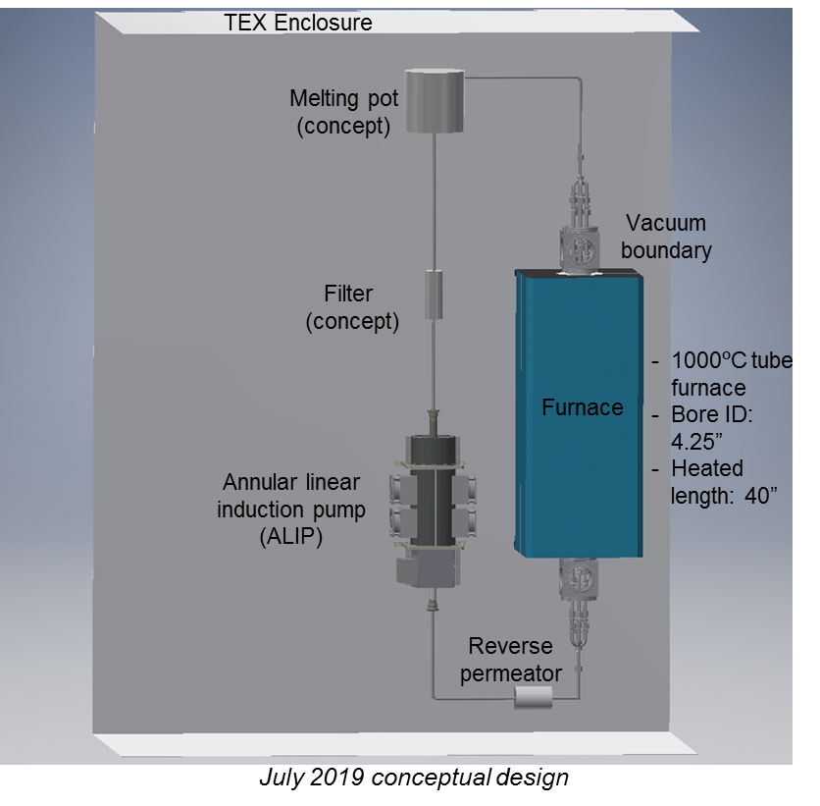
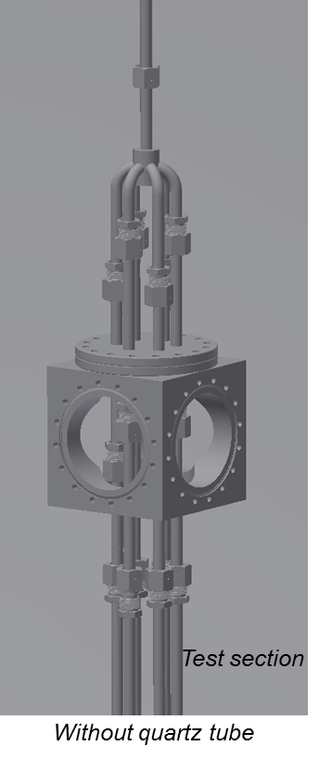
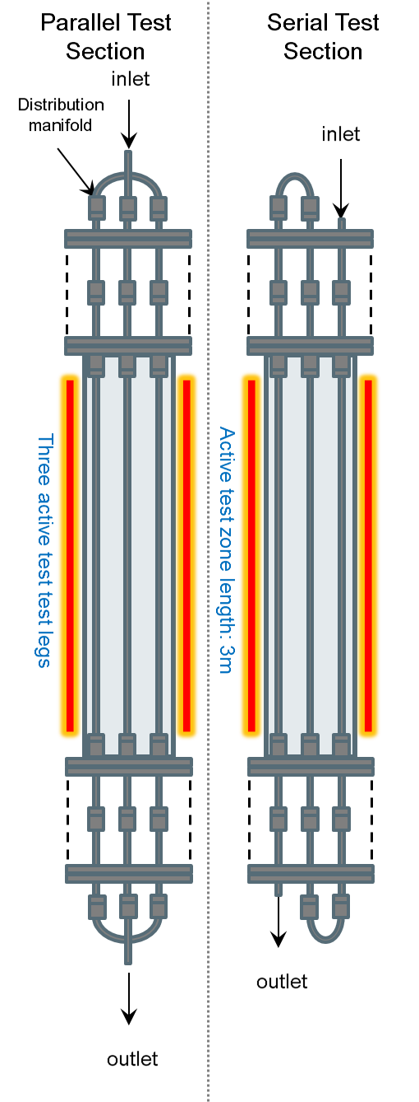
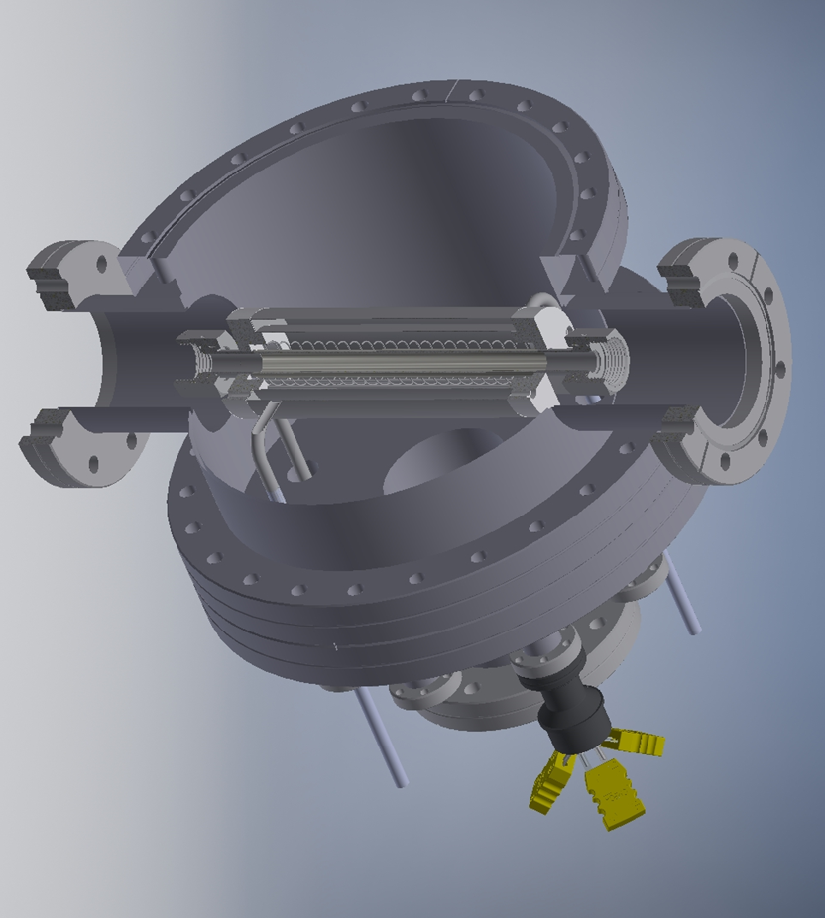
TEX Conceptual Design
Reverse permeator

Slide 19
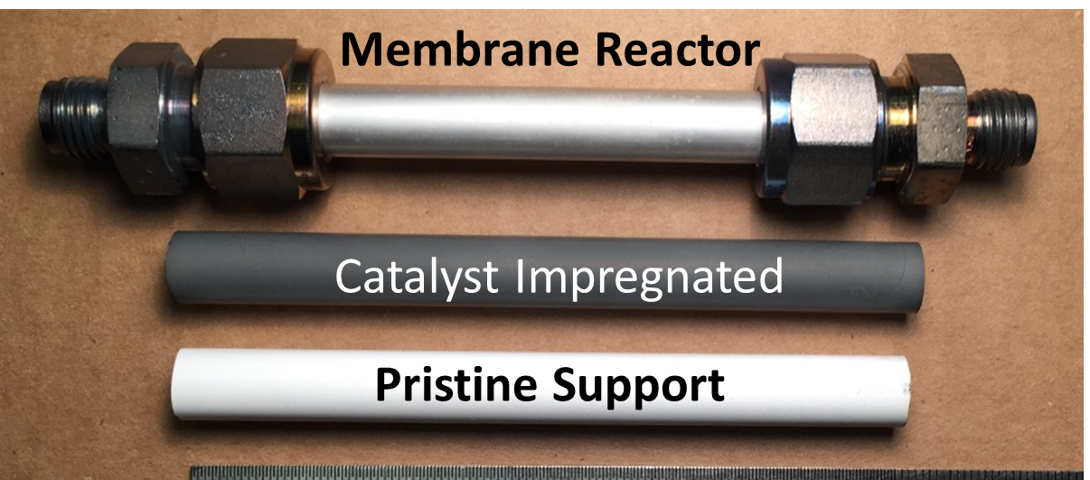
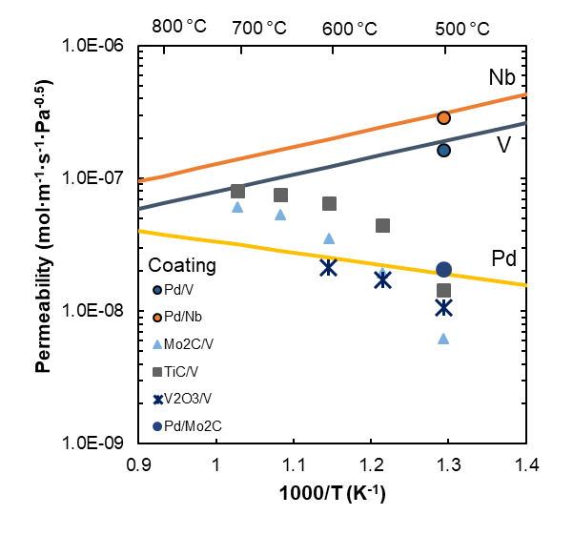
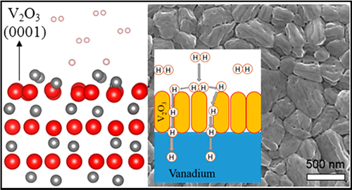
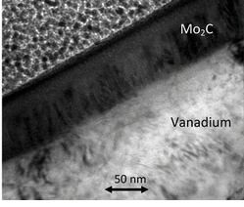
Development of H permeators
Focus on high permeability metals compatible with PbLi (V, Ta, and Fe)
Understand H transport through candidate materials
Investigate coatings (Pd, Mo₂C, etc) to enable high gas-phase hydrogen permeation and oxygen protection for robust use of group V metals
Preliminary work performed by Thomas Fuerst under a DOE Nuclear Energy University Program Fellowship (now a member of FSP)
Z Zheng et al. ACS Sustainable Chem. Eng. (2019) 7 5975
TF Fuerst et al. J. Phys. Chem. C (2018) 122 3488
SK Gade et al. Advanced Materials (2011) 23 3585
T. F. Fuerst (2018) Catalytic coatings for vanadium-based hydrogen membranes. (Doctoral Thesis) Colorado School of Mines, Golden, CO

Slide 20
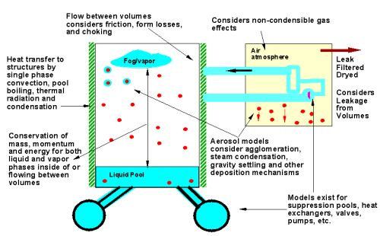
INL MELCOR-TMAP for Fusion Safety Code
MELCOR is an NRC code developed by SNL-NM and is fully integrated, engineering level thermal-hydraulics computer code that models the progression of accidents in fission, including a spectrum of accident phenomena such as reactor cooling system and containment fluid flow, heat transfer, aerosol transport, and tritium transport
MELCOR being used to model fusion reactors by more than 35 users internationally. Models fusion relevant coolants (PbLi, Li, Sn, SnLi, FLiBe, He, etc.) in different cooling systems and treats material oxidation, etc.

Slide 21
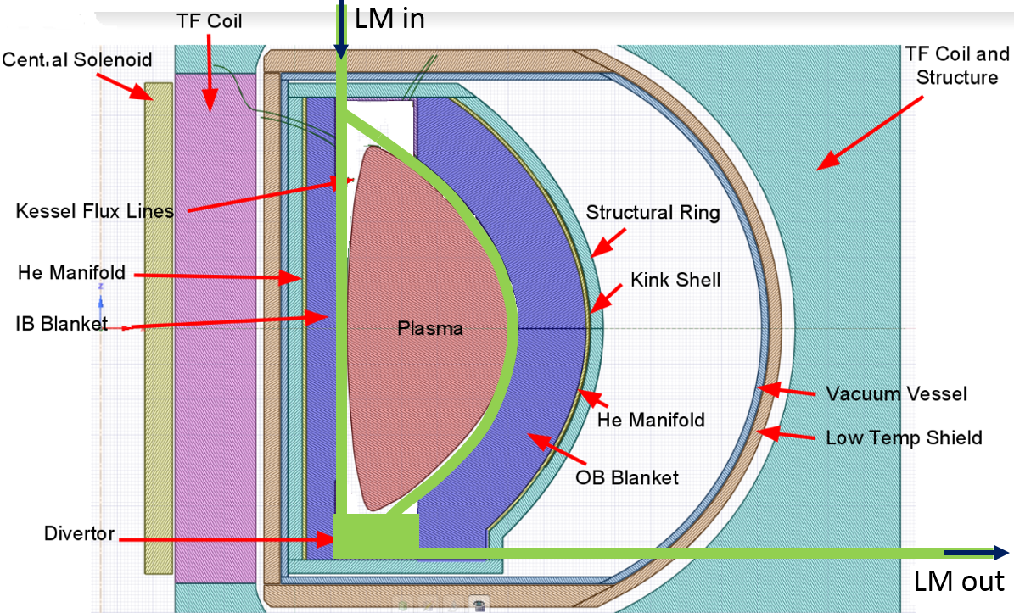
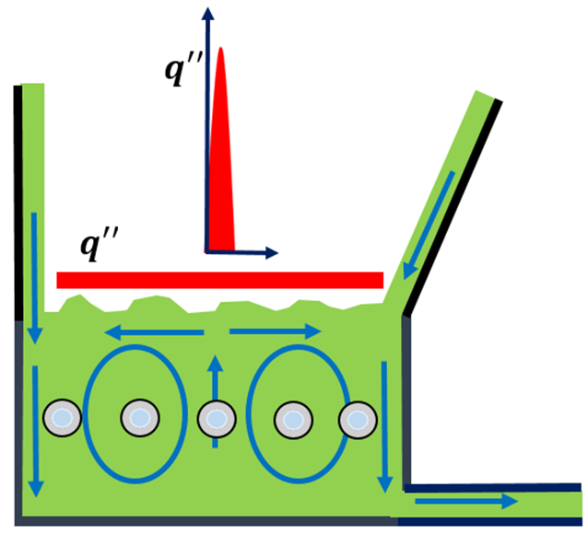
FESS LMPFC study with MELCOR-TMAP
Safety analyses for FESS LM PFC study recently completed
Looked at impacts of adding LM PFCs on steady state tritium permeation with MELCOR/TMAP model
  Low solubility LMs (Sn, presumably SnLi) have minimal impact; losses from blanket PbLi piping predominate
  Li found to have minimal impact on blanket, but is a large sink for implanted tritium
S. Smolentsev,
UCLA
Looked at activation product mobilization from LOCA
  Po-210 a concern for PbLi (from blanket)
  Li concerns such as fires and high tritium inventory
  Sn and SnLi evaporation comparatively benign despite high activation, due to low vapor pressure and thus mobilization of these materials
P. W. Humrickhouse, et al., “The Impacts of Liquid Metal Plasma Facing Components on Fusion Reactor Safety and Tritium Management,” 23rd TOFE, Orlando, FL, in press.

Slide 22
Thank you for your attention

